Slide 1

WSQ
CUSTOMER SERVICE
COURSE SLIDES · WSQ
Improve Your Business with Excellent Customer Service
WSQ Course Code: TGS-2025056191 · 1-Day Hands-On Training
Skills Framework TSC: Customer Service Innovation Management (EPW-CEX-3034-1.1)
Conducted by Tertiary Infotech Academy Pte Ltd · UEN 201200696W
Version v2.0 · 18 August 2026
© 2026 Tertiary Infotech Academy Pte Ltd. All rights reserved. · www.tertiarycourses.com.sg

Slide 2
COURSE ADMINISTRATION
Welcome & Housekeeping
Improve Your Business with Excellent Customer Service · TGS-2025056191
© 2026 Tertiary Infotech Academy Pte Ltd
2

Slide 3
TRAQOM · SSG DIGITAL ATTENDANCE
Digital Attendance (Mandatory)
Three scans, every course day
AM at the start, PM after lunch, and again before the assessment.
The trainer shows the QR
Generated live from the SSG TRAQOM portal — it changes each session.
1
2
Scan with your phone camera
Open the camera, point at the QR, tap the link and submit.
Use your registered details
The NRIC/FIN you enrolled with, or the record will not match.
3
4
75% attendance minimum
Below this you are not eligible for the assessment or for funding.
Tell the trainer immediately
If your scan fails or you arrive late — it cannot be fixed after the day.
5
6
Digital attendance is a mandatory SSG funding requirement — it is not the same thing as the TRAQOM feedback survey.
Improve Your Business with Excellent Customer Service · TGS-2025056191
© 2026 Tertiary Infotech Academy Pte Ltd
3

Slide 4
YOUR TRAINER · GENERAL
About the Trainer
NAME
____________________________________________
?
TITLE / DESIGNATION
____________________________________________
QUALIFICATIONS
____________________________________________
Your Trainer
AREAS OF EXPERTISE
____________________________________________
General Trainer template — to be completed by the trainer
TRAINING & INDUSTRY EXPERIENCE
____________________________________________
CONTACT
____________________________________________
Improve Your Business with Excellent Customer Service · TGS-2025056191
© 2026 Tertiary Infotech Academy Pte Ltd
4

Slide 5
YOUR TRAINER
About the Trainer
ROLE
Principal Trainer, Tertiary Infotech Academy Pte Ltd
AA
BACKGROUND
PhD — 20+ years of industry and training experience across service quality, business operations and technology.
Dr. Alfred Ang
DELIVERS
WSQ courses on customer service, service branding, business improvement and digital skills.
Principal Trainer Tertiary Infotech Academy Pte Ltd
FOUNDER
Founder and lead instructor at Tertiary Infotech / Tertiary Courses.
Improve Your Business with Excellent Customer Service · TGS-2025056191
© 2026 Tertiary Infotech Academy Pte Ltd
5

Slide 6
ICE-BREAKER
Let's Know Each Other
Your name and organisation
And the role you play day to day.
Who your customers are
External, internal, or both — most people have both.
1
2
A recent interaction that went badly
What happened, and what you think caused it.
One that went well
What made the difference on that occasion?
3
4
Your channels
Counter, phone, email, chat — where do you spend most of your time?
What you want from today
One thing you want to do differently tomorrow.
5
6
Improve Your Business with Excellent Customer Service · TGS-2025056191
© 2026 Tertiary Infotech Academy Pte Ltd
6

Slide 7
HOUSEKEEPING
Ground Rules
Set your mobile phone to silent mode.
Participate actively — no question is too small.
1
2
Mutual respect: agree to disagree.
One conversation at a time.
3
4
Be punctual; return from breaks on time.
75% attendance is required for funding.
5
6
Improve Your Business with Excellent Customer Service · TGS-2025056191
© 2026 Tertiary Infotech Academy Pte Ltd
7

Slide 8
COURSE PORTAL · LMS/TMS
Download Course Material
https://lms-tms.tertiaryinfotech.com
Sign in
lms-tms.tertiaryinfotech.com — log in with your registered email (OTP or password).
1
Tertiary Infotech LMS/TMS
My Courses · Attendance · Assessment
Open your course
Select 'Improve Your Business with Excellent Customer Service' under My Courses.
2
Improve Your Business with Excellent Customer Service
Trainer Slides (PDF) ⬇
Download materials
Slides and the Learner Guide — your open-book references for the assessment.
3
Learner Guide (PDF) ⬇
Submit & survey
Upload your assessment answers and complete the TRAQOM survey QR here.
Assessment Submission ↗
4
All course material is downloaded from the LMS/TMS portal — keep it handy: the final assessment is open book.
Improve Your Business with Excellent Customer Service · TGS-2025056191
© 2026 Tertiary Infotech Academy Pte Ltd
8

Slide 9
SCHEDULE
Lesson Plan — 1 Day, 9:00am–6:00pm
Morning — LU1: needs & feedback
Afternoon — LU1 channels + LU2: improvement
• Morning (AM attendance)
– Welcome, introductions, learning outcomes
– Topic 1: Understanding Customers & Service + Activity 1
– Topic 2: Establishing Your Attitude + Activity 2
– Tea break (15 min)
– Topic 3: Identifying Customer Needs + Activity 3
– Topic 4: In-Person Service + Activity 4
– Lunch break 12:50–1:50pm
• Afternoon (PM attendance)
– Topic 5: Phone Service + Activity 5
– Topic 6: Email & Chat Service + Activity 6
– Tea break (15 min)
– Topic 7: Return Business from Feedback + Activity 7
– Topic 8: Recovering Difficult Customers + Activity 8
– Topic 9: When to Escalate + Activity 9
– TRAQOM · Briefing · Assessment (OQ 30 min + RP 30 min)
8 hours: 7 h classroom facilitation + 1 h assessment · 1-hour lunch · tea breaks counted within training time.
Improve Your Business with Excellent Customer Service · TGS-2025056191
© 2026 Tertiary Infotech Academy Pte Ltd
9

Slide 10
WSQ ALIGNMENT
Skills Framework — Customer Service Innovation Management
TSC element
Detail
TSC Title / Code
Customer Service Innovation Management · EPW-CEX-3034-1.1
Ability A1
Carry out collection of customer feedback on service
Ability A2
Determine customer's needs and expectations in relation to products and services
Ability A3
Determine areas of improvement as per customer feedback
Knowledge K1
Principles of effective communication
Knowledge K2
Customer feedback channels
Knowledge K3
Operation and process personnel feedback channels
Every topic, activity and assessment item in this course maps to these TSC abilities and knowledge factors.
Improve Your Business with Excellent Customer Service · TGS-2025056191
© 2026 Tertiary Infotech Academy Pte Ltd
10

Slide 11
BY THE END OF THIS COURSE
Learning Outcomes
LO1
Collect and analyse customer feedback to assess needs and expectations using effective communication principles.
1
LO2
Identify and recommend areas for improvement based on customer feedback and operational insights.
2
Improve Your Business with Excellent Customer Service · TGS-2025056191
© 2026 Tertiary Infotech Academy Pte Ltd
11

Slide 12
THE JOURNEY
Course Outline — Two Learning Units, Nine Topics
Morning
Afternoon
• LU1 — Customer's Needs and Feedback (LO1)
– T1 Understanding Customers & Customer Service
– T2 Establishing Your Service Attitude
– T3 Identifying and Addressing Customer Needs
– T4 In-Person Customer Service
– T5 Customer Service Over the Phone
– T6 Customer Service via Email and Chat
• LU2 — Improving Needs Based on Feedback (LO2)
– T7 Generating Return Business from Feedback
– T8 Recovering Difficult Customers
– T9 Understanding When to Escalate
• 9 real-world case-study activities
– Every topic is practised on a realistic Singapore scenario
– Role plays mirror the Role Play assessment format
Improve Your Business with Excellent Customer Service · TGS-2025056191
© 2026 Tertiary Infotech Academy Pte Ltd
12

Slide 13
BEFORE THE ASSESSMENT
Briefing for Assessment
Clear your workspace
Phones and materials under the table or on the floor.
No photos or recording
Assessment scripts must not be photographed or copied.
1
2
No discussion
The assessment is individual, from the moment it starts.
Black or blue pen only
For hard-copy scripts. No pencil.
3
4
No correction fluid or tape
Strike through a mistake cleanly and write beside it.
Scripts collected on time
When time is up, pens down and hand the script over.
5
6
Open book means the slides, the Learner Guide and approved materials only — not the internet, and not each other.
Improve Your Business with Excellent Customer Service · TGS-2025056191
© 2026 Tertiary Infotech Academy Pte Ltd
13

Slide 14
FINAL ASSESSMENT
Final Assessment
Oral Questioning (OQ) — 30 min
3 open-ended questions covering K1, K2 and K3. Individual, open book.
Role Play (RP) — 30 min
2 simulated customer interactions covering A1, A2 and A3. Individual, open book.
1
2
Open book
Slides, Learner Guide and approved materials only.
Both must be Competent
You must be assessed Competent in BOTH instruments to pass.
3
4
75% attendance required
Attendance and a Competent result are both needed for funding.
Appeals available
You may appeal if you disagree with the assessment outcome.
5
6
Oral Clarification of up to 10 minutes may be conducted 1:1 to close minor performance gaps — this is not counted in the assessment duration.
Improve Your Business with Excellent Customer Service · TGS-2025056191
© 2026 Tertiary Infotech Academy Pte Ltd
14

Slide 15
ON ASSESSMENT DAY
Assessment Flow
1
2
3
4
5
▶
▶
▶
▶
TRAQOM Survey
Assessment Digital Attendance
Assessment (OQ then RP)
Submit on the LMS
Sign the Assessment Summary Record
Improve Your Business with Excellent Customer Service · TGS-2025056191
© 2026 Tertiary Infotech Academy Pte Ltd
15

Slide 16
WHY THIS COURSE MATTERS
Service is not a department.
It is every interaction a customer has with your business — before, during and after the sale.
Improve Your Business with Excellent Customer Service · TGS-2025056191
© 2026 Tertiary Infotech Academy Pte Ltd
16

Slide 17
1
LEARNING UNIT 1
Customer's Needs and Feedback
LO1 · Collect and analyse customer feedback to assess needs and expectations
Improve Your Business with Excellent Customer Service · TGS-2025056191
© 2026 Tertiary Infotech Academy Pte Ltd
17

Slide 18
01
TOPIC 01
Understanding Customers & Customer Service
Who customers are · what service is · who provides it · the service-profit chain
Improve Your Business with Excellent Customer Service · TGS-2025056191
© 2026 Tertiary Infotech Academy Pte Ltd
18

Slide 19
TOPIC 01 · LU1 · K1 · 40 min
Topic 1 — Key Concepts
Service is every interaction
Customer service is the whole of the support a customer receives before, during and after a purchase — not just the complaint desk.
External and internal customers
External customers buy from you; internal customers are colleagues who depend on your output. Both are served.
1
2
Service quality is a chain
Internal support enables frontline delivery, which shapes customer experience, which drives loyalty and revenue.
Service is a growth centre
Help Scout: great service is a growth centre, not a cost centre — retention, referral and lifetime value all flow from it.
3
4
The cost of getting it wrong
86% of customers stop buying after poor experiences; US firms lose over US$62 billion a year to bad service (Help Scout).
Four principles of good service
Help Scout: service must be personalised, competent, convenient and proactive — all four, or the experience breaks.
5
6
Improve Your Business with Excellent Customer Service · TGS-2025056191
© 2026 Tertiary Infotech Academy Pte Ltd
19

Slide 20
THE FULL SERVICE LIFECYCLE
What Customer Service Actually Covers
1
BEFORE
2
DURING
3
AFTER
4
BETWEEN
Pre-sales questions, product advice, quotations, expectation setting. Service starts before any money changes hands.
The transaction itself — ordering, payment, delivery, installation, onboarding.
Support, returns, complaints, follow-up, renewal. Most loyalty is won or lost here.
Proactive contact when nothing is wrong: updates, check-ins, warnings about issues before they bite.
Most organisations resource the middle column well and the last two poorly — which is precisely where retention is decided.
Improve Your Business with Excellent Customer Service · TGS-2025056191
© 2026 Tertiary Infotech Academy Pte Ltd
20

Slide 21
WHO YOU SERVE
External and Internal Customers
EXTERNAL CUSTOMERS
INTERNAL CUSTOMERS
• Buy your product or service and generate revenue.
• Judge you on the outcome AND on how they were treated.
• Can leave — and mostly leave silently, without complaining.
• Their experience is shaped by people they never meet.
• Colleagues and departments who depend on your output.
• Cannot leave — so dissatisfaction shows up as friction, not churn.
• Enable (or block) the frontline's ability to serve.
• Treated as customers, they make external service possible.
The rule that runs through this whole course: excellent external service always begins with strong internal service.
Improve Your Business with Excellent Customer Service · TGS-2025056191
© 2026 Tertiary Infotech Academy Pte Ltd
21

Slide 22
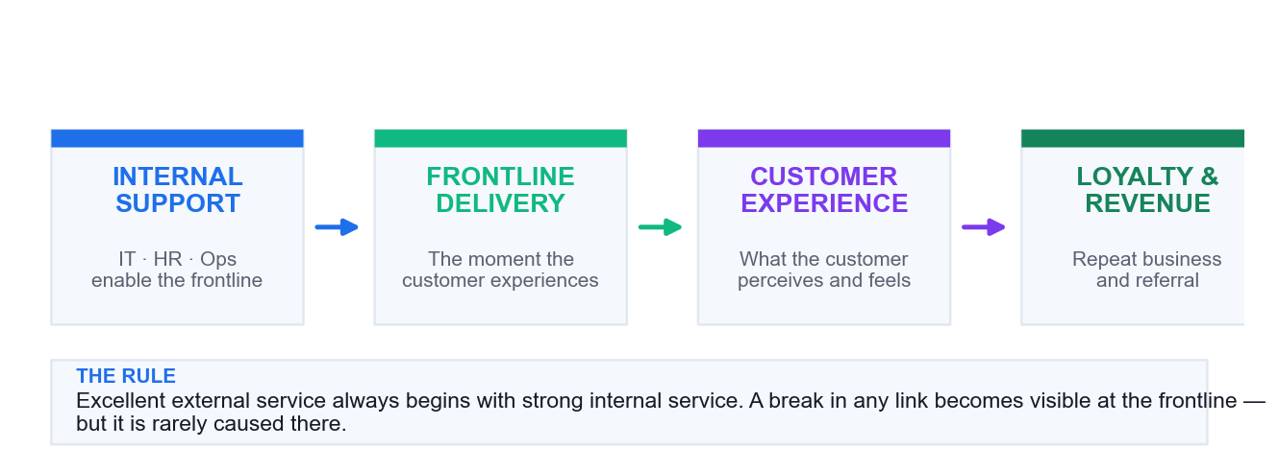
THE SERVICE CHAIN
How Service Quality Actually Flows
Support enables delivery
IT, HR and operations decide what the frontline is even able to offer.
Delivery shapes perception
The customer only ever sees the last link — so that is where blame lands.
Perception drives loyalty
Loyalty and referral are downstream of experience, not of product quality alone.
Break one link, break the chain
A failure anywhere upstream surfaces as a frontline service failure.
Improve Your Business with Excellent Customer Service · TGS-2025056191
© 2026 Tertiary Infotech Academy Pte Ltd
22

Slide 23
HELP SCOUT'S FOUR PRINCIPLES
The Four Principles of Good Service
1
PERSONALISED
2
COMPETENT
3
CONVENIENT
4
PROACTIVE
A human interaction that shows the organisation actually cares about this specific customer.
Strong product knowledge PLUS the authority to act on it. Knowledge without authority frustrates everyone.
Available on the channel the customer prefers, not the one cheapest for you.
You reach out about delays and issues before the customer has to ask.
All four must hold. Personalised but incompetent is charming and useless; competent but inconvenient still loses the customer.
Improve Your Business with Excellent Customer Service · TGS-2025056191
© 2026 Tertiary Infotech Academy Pte Ltd
23

Slide 24
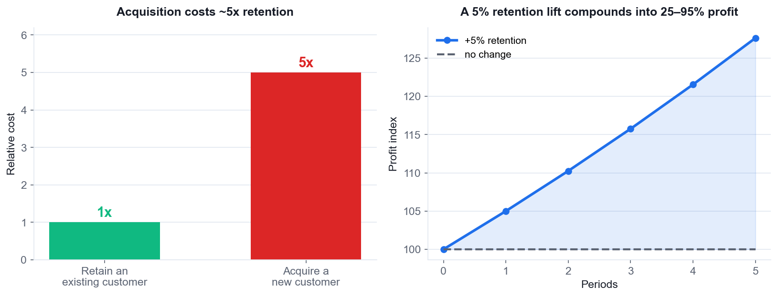
WHY THE BUSINESS SHOULD CARE
The Business Case for Service
Acquisition costs ~5x
Winning a replacement customer costs far more than keeping the one you have.
Retention compounds
A 5% retention improvement can move profit by 25–95% over time.
Poor service drives churn
86% of customers stop buying after poor experiences.
Service is a growth centre
Not a cost centre — the framing decides whether it gets resourced.
Improve Your Business with Excellent Customer Service · TGS-2025056191
© 2026 Tertiary Infotech Academy Pte Ltd
24

Slide 25
SERVICE PROVIDERS
Who Delivers Customer Service
Frontline staff
The first — often only — human contact. They carry the entire perception.
Support and back office
Never seen by the customer, but they determine what the frontline can promise.
1
2
Managers and leaders
Set the standards, the metrics and the amount of authority the frontline has.
Self-service systems
FAQ, chatbots, portals — service delivered without a person, and judged just as harshly.
3
4
Every other department
Product, finance, logistics — each creates or removes friction the customer feels.
The customer themselves
Reviews, referrals and word of mouth extend your service reputation beyond your control.
5
6
Improve Your Business with Excellent Customer Service · TGS-2025056191
© 2026 Tertiary Infotech Academy Pte Ltd
25

Slide 26
TOPIC 01 · CASE STUDY
ACTIVITY 1 · 20 MIN
Activity 1 — Mapping the Service Chain at a Singapore Bank Branch
THE SCENARIO
OCBC-style retail branch, Tampines. Mdm Rohani, 68, comes in to reactivate a dormant savings account so her CPF payout can be credited. The queue ticket says 12 minutes; she waits 47. At the counter, the teller, Wei Ming, finds the reactivation needs a signature-verification form that Operations must approve. Operations is understaffed and quotes 3 working days. Wei Ming has no authority to expedite and no way to see the Operations queue. Mdm Rohani has already made two trips. She says loudly that she will move her account to another bank, and other customers in the queue are listening.
Behind the counter: the branch manager has a service-level dashboard showing counter wait times but not back-office turnaround. Operations measures forms processed per day, not customer trips avoided. The digital team launched an app-based reactivation two months ago that nobody told the branch about.
FORMAT Case Study + Peer Sharing
ROLES Groups of 4–5. Each group maps the chain; one member presents.
Full step-by-step instructions: Learner Guide, Activity 1 · Activities folder: activities/activity-01/
Improve Your Business with Excellent Customer Service · TGS-2025056191
© 2026 Tertiary Infotech Academy Pte Ltd
26

Slide 27
TOPIC 01 · WORK IN YOUR GROUP
Activity 1 — Discussion Questions
1
Who are the EXTERNAL customers in this case, and who are the INTERNAL customers? List every one.
2
Draw the service chain from Mdm Rohani's need to the outcome she actually got. Where exactly did it break?
3
Wei Ming was polite and followed procedure, and the customer still left angry. Whose service failure is this?
4
Operations measures 'forms processed per day'. What behaviour does that metric produce, and what does it miss?
5
The app-based reactivation existed but the branch did not know. What internal service failure does that reveal?
6
Name one change per link in the chain that would have prevented this outcome.
20 minutes · Groups of 4–5. Each group maps the chain; one member presents.
Improve Your Business with Excellent Customer Service · TGS-2025056191
© 2026 Tertiary Infotech Academy Pte Ltd
27

Slide 28
TOPIC 01 · WHAT GOOD LOOKS LIKE
Activity 1 — Debrief
The frontline is where the failure BECOMES VISIBLE, not where it is caused. Wei Ming did nothing wrong — he was set up to fail by the links behind him.
Internal customers here: Wei Ming is Operations' customer; the branch is the digital team's customer; Operations is the branch manager's customer. Every one of those relationships failed.
'Forms processed per day' optimises throughput, not resolution. It is blind to Mdm Rohani's THREE trips — the metric would look healthy while the customer churns.
The undisclosed app feature is a pure internal-communication failure. A capability the frontline does not know about does not exist.
Expected fixes: give the teller visibility of the Operations queue; give SOMEONE authority to expedite; measure customer trips not forms; brief the branch on every new digital capability.
Link back to Topic 1: excellent external service always begins with strong internal service. This case is the proof.
TEST IT Your map names at least 3 internal customers, marks at least 3 broken links, and each fix is a specific action with an owner.
Improve Your Business with Excellent Customer Service · TGS-2025056191
© 2026 Tertiary Infotech Academy Pte Ltd
28

Slide 29
02
TOPIC 02
Establishing Your Service Attitude
Appearance · the power of a smile · staying energised · staying positive · positive language
Improve Your Business with Excellent Customer Service · TGS-2025056191
© 2026 Tertiary Infotech Academy Pte Ltd
29

Slide 30
TOPIC 02 · LU1 · K1 · 40 min
Topic 2 — Key Concepts
Attitude is visible instantly
First impressions form in 4–7 seconds; roughly 55% of that impression comes from appearance and body language.
Emotions are contagious
Your mood transfers to the customer. A genuine smile measurably raises trust and how welcome a guest feels.
1
2
Positive language reframes limits
'That's back-ordered' becomes 'That's available next month — I can reserve it now.' Same fact, different outcome.
Energy must be managed
Service quality decays with fatigue. Structured micro-breaks and shift resets protect the last customer of the day.
3
4
Resilience is a trained skill
Zendesk lists resilience as core: absorbing criticism without letting it degrade the next interaction.
Professionalism is the baseline
Respectful tone, accuracy and appropriate boundaries held consistently — regardless of how the customer behaves.
5
6
Improve Your Business with Excellent Customer Service · TGS-2025056191
© 2026 Tertiary Infotech Academy Pte Ltd
30

Slide 31
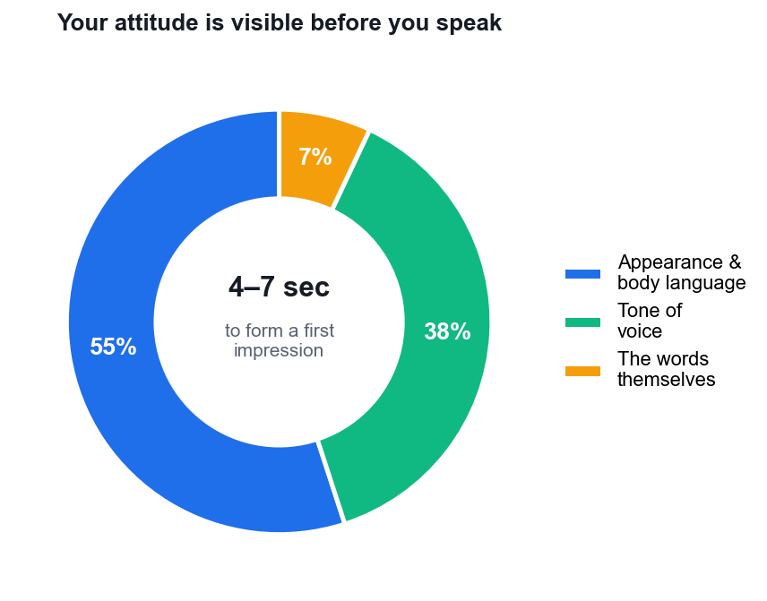
THE ATTITUDE MOMENT
First Impressions Form Before You Speak
4–7 seconds
The window in which the customer decides how this is going to go.
55% is what they see
Grooming, posture, expression — visible before a word is exchanged.
38% is how you sound
Tone, pace and warmth carry more than the words themselves.
7% is what you say
Correct words delivered badly still read as bad service.
Improve Your Business with Excellent Customer Service · TGS-2025056191
© 2026 Tertiary Infotech Academy Pte Ltd
31

Slide 32
ESTABLISHING YOUR ATTITUDE
The Four Pillars of Service Attitude
1
APPEARANCE
2
THE SMILE
3
ENERGY
4
POSITIVITY
Professional grooming signals competence and respect. It is the baseline expectation in Singapore hospitality and retail.
A genuine smile measurably raises trust. A forced one is detected instantly and costs more than none.
Service quality decays with fatigue. Managed breaks protect the last customer of the day.
Reframe the limit into what IS possible. Do not take the complaint personally.
Attitude is not a personality trait you either have or lack — every one of these four pillars is a trainable, repeatable behaviour.
Improve Your Business with Excellent Customer Service · TGS-2025056191
© 2026 Tertiary Infotech Academy Pte Ltd
32

Slide 33
THE HIGHEST-LEVERAGE HABIT IN THIS COURSE
Positive Language — Same Facts, Opposite Outcome
NEGATIVE FRAMING
POSITIVE FRAMING
• "That product is back-ordered and unavailable."
• "I don't know."
• "You have to log out first."
• "That's not our policy."
• "You'll have to pay for that yourself."
• "There's nothing I can do."
• "That's available next month — I can reserve it now."
• "Let me find out for you."
• "Logging out should fix that quickly!"
• "Here's what I can do for you."
• "I can book that for you at the member rate."
• "Let me get someone who can authorise that."
Positive language does not mean saying yes. It means directing the customer to what IS available — with the same underlying answer.
Improve Your Business with Excellent Customer Service · TGS-2025056191
© 2026 Tertiary Infotech Academy Pte Ltd
33

Slide 34
STAYING ENERGISED AND POSITIVE
Managing Yourself Across a Shift
Emotional contagion
Your mood transfers to the customer within seconds — and theirs to you.
Reset between customers
One breath and a deliberate posture reset stops case 11 inheriting case 10's frustration.
1
2
Micro-breaks work
Short structured breaks measurably protect service quality later in the shift.
Depersonalise the complaint
They are angry at the situation, at the company, at their day — not at you.
3
4
Resilience is trainable
Absorb criticism, extract the useful part, discard the rest, start clean.
Know your own tells
Flat tone, short answers, no eye contact — learn to catch your own fatigue signals.
5
6
Improve Your Business with Excellent Customer Service · TGS-2025056191
© 2026 Tertiary Infotech Academy Pte Ltd
34

Slide 35
TOPIC 02 · CASE STUDY
ACTIVITY 2 · 15 MIN
Activity 2 — Attitude and Positive Language at a Changi Airport Service Counter
THE SCENARIO
Changi Airport Terminal 3, airline transfer desk, 11:40pm. Mr Krishnan and his two children (aged 4 and 7) have missed their connecting flight to Chennai because the inbound flight was delayed by weather. The next available flight is 14 hours away. Company policy for weather delays: no hotel accommodation, no meal vouchers, rebooking only. The children are crying. Mr Krishnan has been queueing for 35 minutes and is the eleventh passenger you have seen with the same problem tonight. You are 90 minutes past the end of your shift.
What you CAN do: rebook him on the 1:50pm flight; give him lounge access at your discretion; provide a transit hotel booking form at his own cost; escalate to the duty manager for a goodwill exception.
FORMAT Role Play + Peer Sharing
ROLES Pairs. Role A = Service Officer, Role B = Mr Krishnan. Swap after the first round. Observers score.
Full step-by-step instructions: Learner Guide, Activity 2 · Activities folder: activities/activity-02/
Improve Your Business with Excellent Customer Service · TGS-2025056191
© 2026 Tertiary Infotech Academy Pte Ltd
35

Slide 36
TOPIC 02 · WORK IN YOUR GROUP
Activity 2 — Discussion Questions
1
Rewrite each phrase in positive language: 'We don't cover weather delays.' / 'There's nothing I can do.' / 'You'll have to pay for that yourself.' / 'That's not our policy.' / 'I don't know.'
2
You are 90 minutes past your shift end and this is the eleventh identical case. How does that show up in your body language and voice, even when your words are correct?
3
The answer to 'will you pay for my hotel?' is genuinely no. How do you say no and still leave the customer feeling served?
4
What can you offer that costs the company little but changes how Mr Krishnan experiences this? Name three things.
5
At what point, if any, would you escalate to the duty manager — and what would you say to Mr Krishnan as you do it?
6
The two crying children are not your customer, but they change the interaction. How?
15 minutes · Pairs. Role A = Service Officer, Role B = Mr Krishnan. Swap after the first round. Observers score.
Improve Your Business with Excellent Customer Service · TGS-2025056191
© 2026 Tertiary Infotech Academy Pte Ltd
36

Slide 37
TOPIC 02 · WHAT GOOD LOOKS LIKE
Activity 2 — Debrief
Positive language does not mean saying yes. It means directing the customer to what IS available: 'I can get you on the 1:50pm and into the lounge now' beats 'we don't cover weather delays' with the same underlying answer.
'I don't know' becomes 'let me find out' — the second is the same information plus ownership.
Fatigue leaks through the non-verbal channel first. Words stay professional long after tone and posture have given up. Observers should watch for flat tone, no eye contact, and a sigh before speaking.
The three low-cost offers most groups find: lounge access (comfort for the kids), a proactive rebooking done before he asks, and a printed confirmation so he does not have to re-explain at the next desk.
Acknowledge the children explicitly — the customer's stress is mostly about them. Serving the parent means noticing the kids.
Escalation here is not defeat: naming the duty manager and saying 'I want to ask if we can make an exception for you' shows the customer you are on their side of the counter.
TEST IT You delivered a genuine 'no' inside 2 minutes, offered at least two alternatives unprompted, and your partner reports feeling served rather than dismissed.
Improve Your Business with Excellent Customer Service · TGS-2025056191
© 2026 Tertiary Infotech Academy Pte Ltd
37

Slide 38
Tea Break
15 minutes

Slide 39
03
TOPIC 03
Identifying and Addressing Customer Needs
Active listening · questioning · the four levels of need · going the extra mile
Improve Your Business with Excellent Customer Service · TGS-2025056191
© 2026 Tertiary Infotech Academy Pte Ltd
39

Slide 40
TOPIC 03 · LU1 · K1, A2 · 50 min
Topic 3 — Key Concepts
Needs are functional and emotional
The product must work (functional) and the customer must feel valued (emotional). Missing either loses the customer.
Active listening is the core skill
Attend fully, paraphrase back, read the cues, then confirm. Only 17% of customers believe businesses actually listen (Tidio).
1
2
Ask before you prescribe
Open questions surface the real need; closed questions confirm it. Diagnosing before solving prevents the wrong fix.
Attentiveness reads the unsaid
Repeated 'I couldn't find it' across customers is a UX defect report, not a series of individual questions.
3
4
Four levels of addressing needs
Understand the problem → meet the basic need → think outside the box → go the extra mile.
Personalisation drives loyalty
Use history and context; 35% would rather deal with an AI than repeat themselves to a human (Salesforce).
5
6
Improve Your Business with Excellent Customer Service · TGS-2025056191
© 2026 Tertiary Infotech Academy Pte Ltd
40

Slide 41
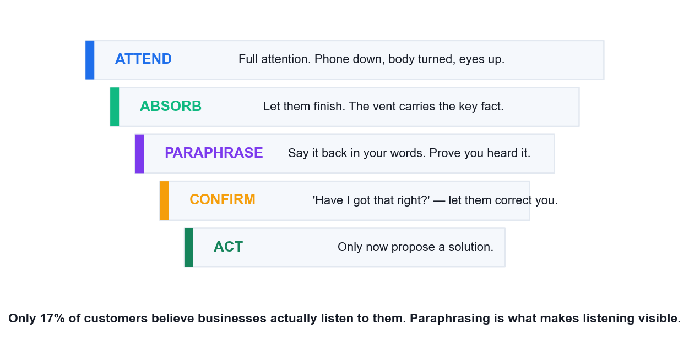
THE CORE SERVICE SKILL
Active Listening — Making Listening Visible
Attend
Full attention. Phone down, body turned, eyes up. Half-attention is detected instantly.
Absorb
Let them finish. The vent almost always contains the key fact.
Paraphrase
Say it back in your own words — this is what makes listening visible.
Confirm, then act
'Have I got that right?' Only after a yes do you propose a solution.
Only 17% of customers believe businesses actually listen to them — paraphrasing is the cheapest way to be in the other 83%.
Improve Your Business with Excellent Customer Service · TGS-2025056191
© 2026 Tertiary Infotech Academy Pte Ltd
41

Slide 42
DIAGNOSE BEFORE YOU PRESCRIBE
Questioning — Open to Explore, Closed to Confirm
CLOSED QUESTIONS (confirm)
OPEN QUESTIONS (explore)
• "Is the account under your name?"
• "Did you receive the confirmation email?"
• "Would Tuesday work for delivery?"
• Use to: pin down facts, confirm, close a decision.
• Risk: asking these first makes it an interrogation.
• "Walk me through what happened."
• "What were you expecting to see?"
• "How is this affecting your work?"
• Use to: surface the real need and the emotion behind it.
• Rule: if it can be answered yes/no, rewrite it.
Open first to understand, closed second to confirm. Reversing the order is the most common needs-identification failure.
Improve Your Business with Excellent Customer Service · TGS-2025056191
© 2026 Tertiary Infotech Academy Pte Ltd
42

Slide 43
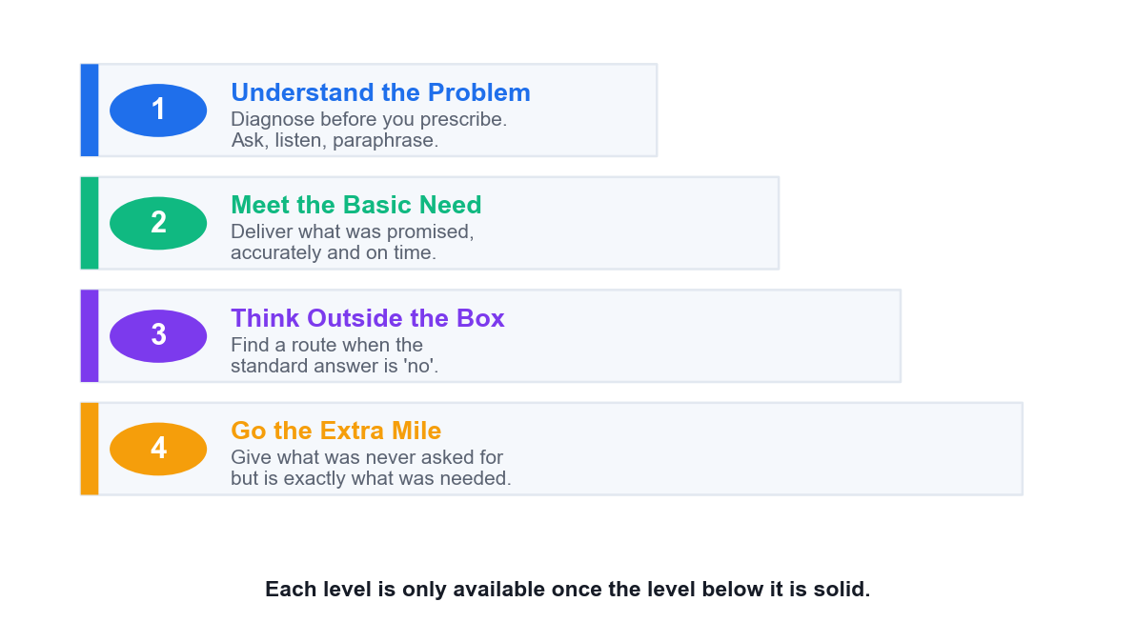
A LADDER, NOT A MENU
The Four Levels of Addressing Customer Needs
1 · Understand
Diagnose the actual problem before offering any solution.
2 · Meet the basic need
Deliver what was promised, accurately and on time. Non-negotiable.
3 · Outside the box
Find a route when the standard answer is 'no'.
4 · The extra mile
Give what was never asked for but was exactly what was needed.
Level 4 delivered while level 2 is failing reads as a distraction — you cannot skip the rungs.
Improve Your Business with Excellent Customer Service · TGS-2025056191
© 2026 Tertiary Infotech Academy Pte Ltd
43

Slide 44
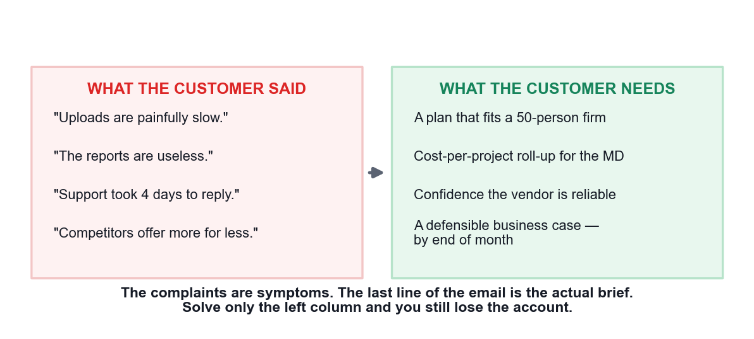
THE INFERENCE THAT MATTERS
What They Said vs What They Need
Complaints are symptoms
The stated problem is where they started, not where the need lives.
Functional vs emotional
The product must work AND the customer must feel valued.
Listen for the deadline
The real brief is often the last sentence, not the first.
Attentiveness reads patterns
The same complaint from many customers is a defect report.
Improve Your Business with Excellent Customer Service · TGS-2025056191
© 2026 Tertiary Infotech Academy Pte Ltd
44

Slide 45
TOPIC 03 · CASE STUDY
ACTIVITY 3 · 20 MIN
Activity 3 — Diagnosing Customer Needs at a Growing SME — TechNova Account Review
THE SCENARIO
TechNova Solutions (Singapore) supplies a cloud project-management platform. Mr Daniel Lim is Operations Director at Horizon Builders Pte Ltd, a Woodlands-based construction firm and a customer for 6 years. Horizon has grown from 12 to 50 employees. Daniel emails: 'Uploads are painfully slow, the reports are useless for what we need, and it took your support team 4 days to answer my last ticket. Competitors are offering us more for less. I need to justify this renewal to my MD by end of month.'
What the account record shows: Horizon is on Team Pro (a 15-seat plan) with 50 users sharing logins. Upload slowness correlates with 200MB+ site photo batches — the plan caps concurrent uploads. The reporting Daniel wants (cost-per-project roll-up) exists in the Enterprise tier. The 4-day ticket was logged during the Chinese New Year holiday period. Daniel has never had a formal account review in 6 years.
FORMAT Case Study + Role Play
ROLES Pairs. Role A = TechNova Account Manager, Role B = Daniel Lim. Assessor-style observer optional.
Full step-by-step instructions: Learner Guide, Activity 3 · Activities folder: activities/activity-03/
Improve Your Business with Excellent Customer Service · TGS-2025056191
© 2026 Tertiary Infotech Academy Pte Ltd
45

Slide 46
TOPIC 03 · WORK IN YOUR GROUP
Activity 3 — Discussion Questions
1
Separate what Daniel SAID from what Daniel NEEDS. Write two columns. They are not the same list.
2
Identify Daniel's FUNCTIONAL needs and his EMOTIONAL needs. Which one is driving the email's tone?
3
'I need to justify this renewal to my MD by end of month.' What does this sentence tell you that the complaints do not?
4
Map your findings to the four levels: understand the problem / meet basic needs / think outside the box / go the extra mile. What sits at each level?
5
Horizon has 50 users on a 15-seat plan. This is a contract breach AND the cause of the slowness. How do you raise it without turning a save into a fight?
6
Six years, no account review. What does that reveal about TechNova's own service process — and what should change?
20 minutes · Pairs. Role A = TechNova Account Manager, Role B = Daniel Lim. Assessor-style observer optional.
Improve Your Business with Excellent Customer Service · TGS-2025056191
© 2026 Tertiary Infotech Academy Pte Ltd
46

Slide 47
TOPIC 03 · WHAT GOOD LOOKS LIKE
Activity 3 — Debrief
Said vs needed: he SAYS slow uploads, useless reports, slow support. He NEEDS a defensible business case for his MD by month end. Solve only the first three and you still lose the account.
The emotional need is dominant: Daniel is exposed in front of his MD. The functional fixes are the evidence he needs to not look foolish for having stayed 6 years.
The last sentence is the actual brief. Everything before it is symptoms. Learners who spot this are doing genuine needs identification rather than complaint triage.
Four levels — understand: the plan no longer fits a 50-person firm. Basic: fix the upload cap and the ticket SLA. Outside the box: the seat overage is leverage for a migration, not a penalty. Extra mile: build the cost-per-project report FOR his MD deck.
The 15-seat breach must be raised as a discovery, not an accusation: 'your growth has outrun the plan we sold you six years ago — that's on us for not reviewing it.'
The real service failure is TechNova's: no account review in 6 years means nobody was listening until the customer shouted. The process fix is a scheduled review cadence — this is a Topic 7 closed-loop point arriving early.
TEST IT Your needs analysis has at least one emotional need identified, all four levels populated, and your role-play partner confirms you surfaced the MD deadline as the real brief.
Improve Your Business with Excellent Customer Service · TGS-2025056191
© 2026 Tertiary Infotech Academy Pte Ltd
47

Slide 48
04
TOPIC 04
In-Person Customer Service
Walk-ins and at-your-desk requests · body language · advantages and limits of face-to-face
Improve Your Business with Excellent Customer Service · TGS-2025056191
© 2026 Tertiary Infotech Academy Pte Ltd
48

Slide 49
TOPIC 04 · LU1 · K1, A1 · 45 min
Topic 4 — Key Concepts
Face-to-face is highest bandwidth
Tone, posture, expression and timing all carry meaning that text channels strip away.
Immediate feedback loop
Misunderstandings surface and are corrected within seconds — the strongest advantage over email or chat.
1
2
Body language you control
Open posture, ~70% eye contact, a slight forward lean and subtle mirroring build rapport without a word.
Signals that cost you trust
Crossed arms, glancing at a phone, turning away or a fixed forced smile all read as disengagement.
3
4
Acknowledge within seconds
Greet a walk-in within about 3 seconds even when occupied; being seen matters before being served.
The limits of in-person
No automatic record, queueing pressure and scheduling conflicts — document afterwards or it never happened.
5
6
Improve Your Business with Excellent Customer Service · TGS-2025056191
© 2026 Tertiary Infotech Academy Pte Ltd
49

Slide 50
CHOOSING FACE-TO-FACE
In-Person Service — Strengths and Limits
THE LIMITATIONS
THE ADVANTAGES
• No automatic record — if you don't write it down, it didn't happen.
• Queueing pressure: everyone waiting sees how long you take.
• You can only serve one person at a time.
• Scheduling conflicts and walk-in unpredictability.
• Harder to escalate discreetly with an audience present.
• Immediate feedback — misunderstandings die in seconds.
• Full non-verbal bandwidth: posture, expression, timing.
• Strongest channel for building trust and rapport.
• Easiest channel on which to de-escalate genuine anger.
• You can show, demonstrate and hand over physically.
The channel's great weakness is memory: always follow a face-to-face resolution with a written summary.
Improve Your Business with Excellent Customer Service · TGS-2025056191
© 2026 Tertiary Infotech Academy Pte Ltd
50

Slide 51
THE NON-VERBAL CHANNEL
Body Language You Control
1
POSTURE
2
EYE CONTACT
3
MIRRORING
4
THE SMILE
Open and uncrossed, with a slight forward lean. Signals engagement and honesty.
Around 70% of the time. Constant staring intimidates; avoidance reads as dishonesty.
Subtly match their pace and energy. Builds rapport below conscious awareness.
Genuine and brief at greeting. It sets the emotional tone for everything after.
Signals that cost you trust: crossed arms, glancing at your phone, turning your torso away, or a fixed forced smile.
Improve Your Business with Excellent Customer Service · TGS-2025056191
© 2026 Tertiary Infotech Academy Pte Ltd
51

Slide 52
THE PARK AND RETURN METHOD
Handling a Walk-In While You Are Already Busy
1
Acknowledge within 3 seconds
Eye contact, a raised hand, 'I'll be right with you.' Being SEEN precedes being served.
2
Give a realistic wait
'About two minutes' buys you two minutes. A vague wait buys you nothing.
3
Protect the active customer
The person you are serving keeps priority — say so openly so the queue hears the rule.
4
Note your park point
Record where you stopped so you resume without making anyone repeat themselves.
5
Return and reference
Open with what they told you: 'you mentioned a cracked screen' proves you were listening.
6
Close with next steps
Summarise what happens now, so they leave with certainty rather than hope.
Making a customer re-explain their problem is the single failure this method exists to prevent.
Improve Your Business with Excellent Customer Service · TGS-2025056191
© 2026 Tertiary Infotech Academy Pte Ltd
52

Slide 53
TOPIC 04 · CASE STUDY
ACTIVITY 4 · 15 MIN
Activity 4 — The Walk-In Interruption — Retail Service Counter, Bugis
THE SCENARIO
A telco retail store at Bugis Junction, Saturday 2pm. You are at the service counter finishing a SIM registration for a customer who is standing beside you waiting for the confirmation SMS. The store phone rings. At the same moment, Ms Chen walks up to your counter holding a phone with a cracked screen and says 'Excuse me, I just need a quick answer' — she has been in the store for 20 minutes looking for someone. Two more customers are visibly waiting behind her.
You cannot serve three people at once. Everything you do in the next 15 seconds is visible to all of them.
FORMAT Role Play
ROLES Groups of 4. Role A = Service Officer, B = SIM customer, C = Ms Chen, D = observer/phone caller.
Full step-by-step instructions: Learner Guide, Activity 4 · Activities folder: activities/activity-04/
Improve Your Business with Excellent Customer Service · TGS-2025056191
© 2026 Tertiary Infotech Academy Pte Ltd
53

Slide 54
TOPIC 04 · WORK IN YOUR GROUP
Activity 4 — Discussion Questions
1
In the first 15 seconds, what do you do — and in what order? Be specific about words, eyes and hands.
2
Ms Chen says 'I just need a quick answer'. Is it ever actually quick? What is the risk of treating it as quick?
3
How do you acknowledge Ms Chen without abandoning the customer already at your counter?
4
The phone is ringing and no one else can take it. What do you do, and what does the customer in front of you see you do?
5
What body language keeps all three parties feeling attended to while you can only serve one?
6
What is the 'park and return' method, and where exactly would you use it here?
15 minutes · Groups of 4. Role A = Service Officer, B = SIM customer, C = Ms Chen, D = observer/phone caller.
Improve Your Business with Excellent Customer Service · TGS-2025056191
© 2026 Tertiary Infotech Academy Pte Ltd
54

Slide 55
TOPIC 04 · WHAT GOOD LOOKS LIKE
Activity 4 — Debrief
Order matters: eye contact + a raised hand + 'I'll be right with you, about two minutes' to Ms Chen takes 3 seconds and buys 2 minutes. Being SEEN precedes being served.
'Quick answer' is almost never quick — a cracked screen means warranty status, purchase date, insurance and a repair booking. Treating it as quick means starting something you cannot finish and now failing two customers.
The customer in front of you keeps priority. State that openly to the room: it reassures the person you are serving AND tells the queue there is a fair rule.
The phone: let it go to the queue or answer with 'may I take your number and call you back in five minutes?' Never leave a physical customer standing while you have a full phone conversation — the person present outranks the person calling.
Body language: keep your torso oriented to the counter customer, turn only your head to Ms Chen, and use an open palm rather than a pointed finger. Turning your whole body away is the abandonment signal.
Park and return: note where you were in the SIM registration before you turn away, so you resume without asking the first customer to repeat anything. Making a customer re-explain is the failure this method exists to prevent.
TEST IT You acknowledged the walk-in within 5 seconds, no customer was asked to repeat themselves, and the observer confirms you never fully turned away from the customer you were actively serving.
Improve Your Business with Excellent Customer Service · TGS-2025056191
© 2026 Tertiary Infotech Academy Pte Ltd
55

Slide 56
Lunch Break
12:50pm – 1:50pm

Slide 57
05
TOPIC 05
Customer Service Over the Phone
Telephone etiquette · voice as the whole channel · hold and transfer · call structure
Improve Your Business with Excellent Customer Service · TGS-2025056191
© 2026 Tertiary Infotech Academy Pte Ltd
57

Slide 58
TOPIC 05 · LU1 · K1, A1 · 45 min
Topic 5 — Key Concepts
Voice carries everything
With no visual channel, tone, pace and warmth do all the work that body language does in person.
Phone still dominates complex issues
When an issue needs back-and-forth clarification, customers still reach for the phone over text channels.
1
2
Etiquette is measurable
Answer within three rings, smile while speaking, never interrupt, avoid jargon, always close with next steps.
Hold is a permission, not an action
Ask before holding, explain why, give a time, thank them on return — otherwise it reads as being dumped.
3
4
Paraphrase to prove you listened
'So the order was due Monday and hasn't arrived' converts a vent into a defined, solvable problem.
Scripts guide, they don't speak
Rigid scripts sound robotic. Use them as a spine and personalise the words to the caller in front of you.
5
6
Improve Your Business with Excellent Customer Service · TGS-2025056191
© 2026 Tertiary Infotech Academy Pte Ltd
58

Slide 59
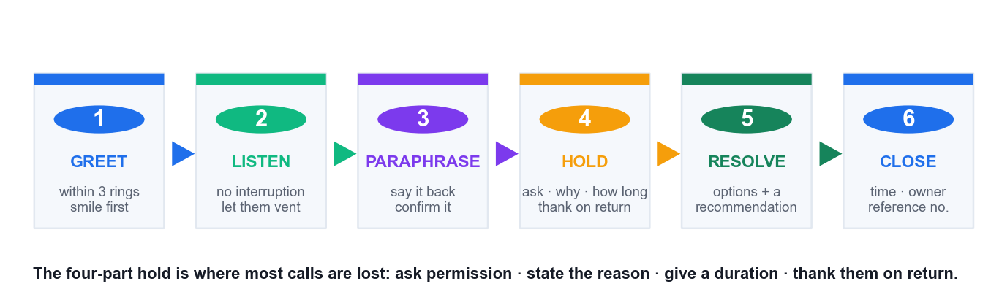
THE CALL STRUCTURE
The Professional Call — Six Stages
Greet and listen
Within three rings, smile first, then let them finish without interruption.
Paraphrase and confirm
Say the whole issue back. Wait for their yes before moving on.
Hold properly
Ask, explain, give a duration, thank them on return. All four, every time.
Resolve and close
Options with a recommendation, then a time, an owner and a reference number.
Improve Your Business with Excellent Customer Service · TGS-2025056191
© 2026 Tertiary Infotech Academy Pte Ltd
59

Slide 60
TELEPHONE ETIQUETTE
Telephone Service — What Loses and Wins Calls
WHAT LOSES THE CALL
WHAT WINS THE CALL
• Interrupting to defend the company mid-vent.
• Silent hold with no reason and no time given.
• Reading a rigid script — it sounds robotic instantly.
• Jargon and internal system names.
• Vague closes: 'we'll look into it and get back to you.'
• Transferring without explaining or introducing.
• Letting the first 30–45 seconds run — the key fact is in there.
• Smiling before you speak — it changes your voice audibly.
• Using their name naturally, two or three times.
• Paraphrasing before proposing anything.
• A specific time, a named owner and a reference number.
• One proactive follow-up call, made whether or not it worked.
With no visual channel, tone and pace do all the work that posture and expression do in person.
Improve Your Business with Excellent Customer Service · TGS-2025056191
© 2026 Tertiary Infotech Academy Pte Ltd
60

Slide 61
WHERE MOST CALLS ARE LOST
Placing a Customer on Hold — the Four Parts
Ask permission
'May I put you on hold for a moment?' — then actually wait for the answer.
1
State the reason
'…while I get my supervisor to authorise the re-route.' Reason converts waiting into progress.
2
Give a realistic duration
'About three minutes.' Then beat it, or come back and re-contract.
3
Thank them on return
'Thank you for waiting.' Missing this one part makes the whole hold feel like being dumped.
4
A hold is a permission you are granted, not an action you perform on the customer.
Improve Your Business with Excellent Customer Service · TGS-2025056191
© 2026 Tertiary Infotech Academy Pte Ltd
61

Slide 62
TOPIC 05 · CASE STUDY
ACTIVITY 5 · 15 MIN
Activity 5 — The Angry Delivery Call — Logistics Hotline
THE SCENARIO
You work the customer hotline for a Singapore last-mile logistics firm. Mr Faisal calls at 4:15pm. His package — a replacement CPAP machine part his father needs — was due Monday. It is now Thursday. Tracking has said 'out for delivery' for three days. He has called twice before; both times he was told 'it will be delivered today'. He opens the call at volume: 'I've been lied to twice. Don't tell me it's out for delivery. Where is my package?'
What you find while he is talking: the parcel was mis-sorted to the Jurong hub on Monday, scanned back out Wednesday, and is genuinely on a van today — but the van's route ends at 9pm and he is stop 61 of 68. You can request a priority re-route (needs hub supervisor approval, ~10 minutes) or offer next-morning guaranteed delivery before 10am.
FORMAT Role Play
ROLES Pairs, seated back to back so there is no visual channel. A = Hotline Officer, B = Mr Faisal.
Full step-by-step instructions: Learner Guide, Activity 5 · Activities folder: activities/activity-05/
Improve Your Business with Excellent Customer Service · TGS-2025056191
© 2026 Tertiary Infotech Academy Pte Ltd
62

Slide 63
TOPIC 05 · WORK IN YOUR GROUP
Activity 5 — Discussion Questions
1
Mr Faisal opens by shouting. What are your first words, and how long do you let him talk before you speak?
2
He says 'I've been lied to twice.' Is that true? How do you respond to it without blaming a colleague or defending the company?
3
Write the exact sentence you would use to paraphrase his issue back to him.
4
You need 10 minutes to get supervisor approval. How do you place him on hold correctly — what four things must you say?
5
You have two options (priority re-route vs guaranteed next morning). Do you choose for him or offer both? Why?
6
Why does the CPAP detail change how you handle this call, and what would you have missed if you had interrupted him?
15 minutes · Pairs, seated back to back so there is no visual channel. A = Hotline Officer, B = Mr Faisal.
Improve Your Business with Excellent Customer Service · TGS-2025056191
© 2026 Tertiary Infotech Academy Pte Ltd
63

Slide 64
TOPIC 05 · WHAT GOOD LOOKS LIKE
Activity 5 — Debrief
Let him finish. The first 30–45 seconds are venting and contain the CPAP detail — the single most important fact in the call. An officer who interrupts to defend the tracking system never learns why this parcel matters.
'I've been lied to twice' — do not defend and do not blame. 'You were given a delivery promise twice and it did not happen. That's on us.' Acknowledging the customer's EXPERIENCE is not admitting to a lie.
Good paraphrase: 'So your father's CPAP part was promised Monday, you've called twice, been told it's out for delivery each time, and four days on you still have nothing.' Naming the father is what proves you listened.
Correct hold has four parts: ask permission, state the reason, give a realistic duration, thank them on return. Missing any one of these makes the hold feel like being dumped.
Offer both options with a recommendation. The CPAP context makes guaranteed 10am delivery likely better than stop 61 at 9pm — but it is his father and his call. Choosing FOR the customer removes the one piece of control he still has.
This call is a Topic 7 case in disguise: the mis-sort is the fault, but the SERVICE failure is two false promises. Note it for the feedback loop — the fix is not promising a date the system cannot see.
TEST IT You did not interrupt during the opening vent, your paraphrase included the father/CPAP detail, your hold had all four elements, and your close named a specific time and owner.
Improve Your Business with Excellent Customer Service · TGS-2025056191
© 2026 Tertiary Infotech Academy Pte Ltd
64

Slide 65
06
TOPIC 06
Customer Service via Email and Chat
Netiquette · email structure · written tone · choosing between email and live chat
Improve Your Business with Excellent Customer Service · TGS-2025056191
© 2026 Tertiary Infotech Academy Pte Ltd
65

Slide 66
TOPIC 06 · LU1 · K1, K2, A1 · 40 min
Topic 6 — Key Concepts
Writing is a service skill
'You have to log out first' and 'Logging out should fix that quickly!' carry identical information and opposite tone.
Email creates the record
The written trail is the channel's real advantage: the customer can re-read it and you can prove what was agreed.
1
2
Netiquette rules are not optional
No ALL CAPS, no unexplained jargon, a clear action-oriented subject line and a real signature block.
A five-part email structure
Personalised greeting → acknowledge the issue → give the solution → state next steps → professional sign-off.
3
4
Email vs live chat
Email suits complex, documented, attachment-bearing issues; chat suits short, real-time, single-question issues.
Proofread before you send
Grammar and spelling errors read as carelessness and quietly transfer to how the customer rates your competence.
5
6
Improve Your Business with Excellent Customer Service · TGS-2025056191
© 2026 Tertiary Infotech Academy Pte Ltd
66

Slide 67
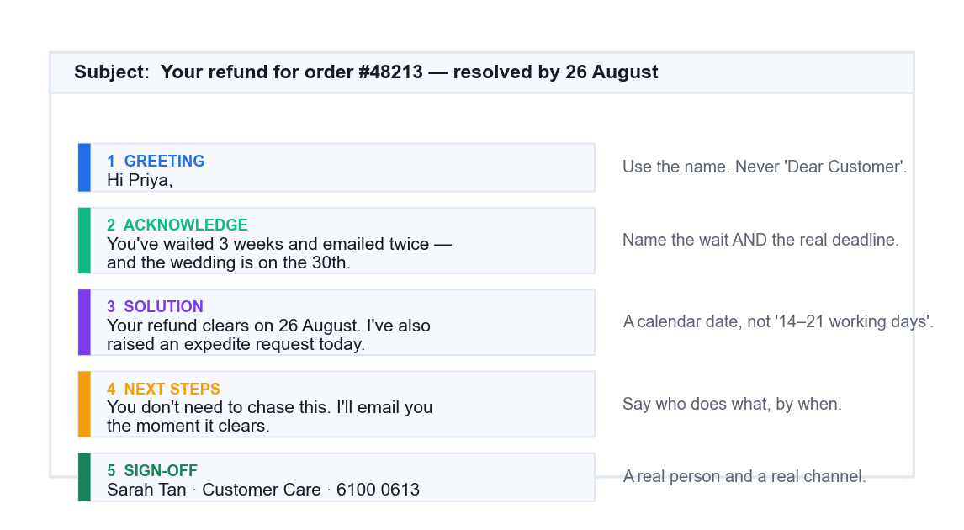
THE FIVE-PART STRUCTURE
The Anatomy of a Service Email
Greeting
Their name, always. 'Dear Customer' announces that nobody read the file.
Acknowledge
Name the wait, the prior contacts and the real deadline before anything else.
Solution
A calendar date, not a working-day range. Ranges read as evasion.
Next steps + sign-off
Who does what by when — signed by a real, named person.
Improve Your Business with Excellent Customer Service · TGS-2025056191
© 2026 Tertiary Infotech Academy Pte Ltd
67

Slide 68
WRITTEN TONE IS A SERVICE SKILL
Netiquette — What Breaks a Service Email
NEVER
ALWAYS
• ALL CAPS — it reads as shouting.
• 'Dear Customer' when you have their name on file.
• Policy citations as an answer ('per T&C 7.3').
• 'Please do not email again' — you just closed their only channel.
• Unsigned 'Support Team' with no human name.
• Dead subject lines: 'RE: RE: FW: order'.
• A clear, action-oriented subject line.
• Their name, and a reference to their history with you.
• Plain language — explain the policy, don't cite it.
• A concrete date and a named owner.
• A real signature: name, role, direct contact.
• A proofread pass before you send.
An email can be 100% factually correct and still be a total service failure — accuracy is not the same as service.
Improve Your Business with Excellent Customer Service · TGS-2025056191
© 2026 Tertiary Infotech Academy Pte Ltd
68

Slide 69
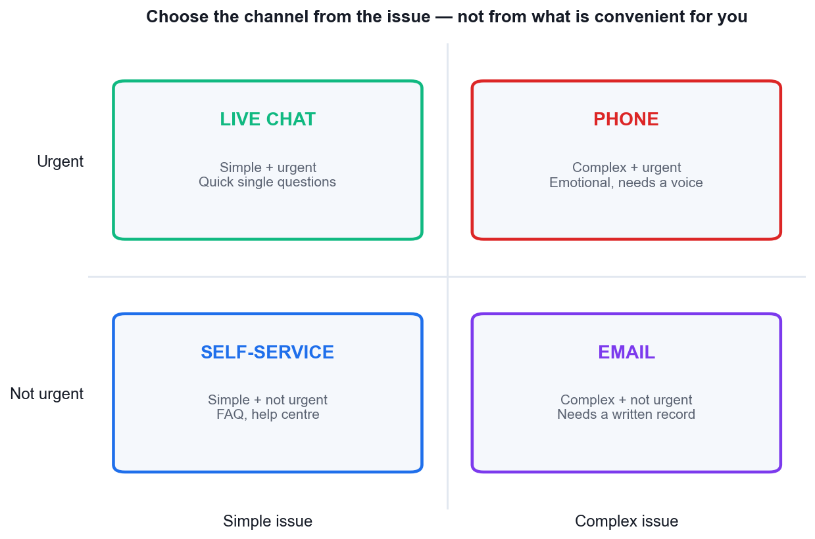
MATCH THE CHANNEL TO THE ISSUE
Choosing the Right Channel
Phone
Complex and urgent, or emotionally charged. Voice carries what text cannot.
Live chat
Simple and urgent — one quick question, answered in real time.
Email
Complex, not urgent, needs attachments and a durable written record.
Self-service
Simple and not urgent — FAQ and help centre, available at 3am.
Best practice for a time-critical emotional issue: call first, then confirm in writing — use each channel for what it does well.
Improve Your Business with Excellent Customer Service · TGS-2025056191
© 2026 Tertiary Infotech Academy Pte Ltd
69

Slide 70
TOPIC 06 · CASE STUDY
ACTIVITY 6 · 15 MIN
Activity 6 — Rewriting the Refund Email — E-Commerce Support Inbox
THE SCENARIO
A Singapore online fashion retailer. Ms Priya ordered a dress for her sister's wedding on 2 August, paid S$189, and received the wrong size. She returned it on 8 August using the prepaid label. It is now 22 August, no refund has appeared, and the wedding is on 30 August. She has emailed twice.
The agent's reply, sent as-is:
Subject: RE: RE: FW: order
FORMAT Case Study + Practical Writing
ROLES Individually, then compare in pairs.
Full step-by-step instructions: Learner Guide, Activity 6 · Activities folder: activities/activity-06/
Improve Your Business with Excellent Customer Service · TGS-2025056191
© 2026 Tertiary Infotech Academy Pte Ltd
70

Slide 71
TOPIC 06 · WORK IN YOUR GROUP
Activity 6 — Discussion Questions
1
List every netiquette failure in the agent's email. There are at least seven.
2
Every fact in the email is accurate. Explain how an email can be 100% correct and still be a service failure.
3
What is the customer's REAL deadline, and does the agent's reply acknowledge it at all?
4
Rewrite the email using the five-part structure: greeting → acknowledge → solution → next steps → sign-off.
5
'Please do not email again.' What does this sentence do to the relationship, and what should replace it?
6
Should this have been email, live chat or a phone call? Justify your choice against the channel-selection rule.
15 minutes · Individually, then compare in pairs.
Improve Your Business with Excellent Customer Service · TGS-2025056191
© 2026 Tertiary Infotech Academy Pte Ltd
71

Slide 72
TOPIC 06 · WHAT GOOD LOOKS LIKE
Activity 6 — Debrief
Netiquette failures to find: 'RE: RE: FW: order' subject line, 'Dear Customer' not her name, ALL CAPS as shouting, policy-section jargon (T&C 7.3), no apology or acknowledgement, an instruction not to make contact, an unsigned 'Support Team' with no individual name, and no next step the customer can act on.
Correct-but-failing is the key lesson: the agent answered the question the customer TYPED and ignored the question she MEANT — 'will I have this sorted before the wedding on the 30th?'
The wedding date is the real deadline and the email never mentions it. This is the same 'said vs needed' distinction from Activity 3, in writing.
A good rewrite names Priya, acknowledges two prior emails and the wedding, states the refund date with a specific day, offers something concrete (expedite request, or a replacement in the right size shipped now), and gives a named person and direct contact.
'Please do not email again' tells the customer her only channel is closed. Replace with proactive ownership: 'You don't need to chase this — I'll email you the moment it clears, and here's my direct line.'
Channel: email is right for the RECORD (money, dates, policy), but this case needed a phone call first because it is time-critical and emotional. Best practice is call, then confirm in writing — using both channels for what each does well.
TEST IT Your rewrite has all five parts, names the customer, acknowledges the 30 August wedding, gives a calendar date rather than a working-day range, and is signed by a named person.
Improve Your Business with Excellent Customer Service · TGS-2025056191
© 2026 Tertiary Infotech Academy Pte Ltd
72

Slide 73
Tea Break
15 minutes

Slide 74
2
LEARNING UNIT 2
Improving Customer's Needs Based on Feedback
LO2 · Identify and recommend areas for improvement from feedback and operational insight
Improve Your Business with Excellent Customer Service · TGS-2025056191
© 2026 Tertiary Infotech Academy Pte Ltd
74

Slide 75
07
TOPIC 07
Generating Return Business from Feedback
Feedback channels · closing the loop · complaint handling · retention economics
Improve Your Business with Excellent Customer Service · TGS-2025056191
© 2026 Tertiary Infotech Academy Pte Ltd
75

Slide 76
TOPIC 07 · LU2 · K2, A1, A3 · 55 min
Topic 7 — Key Concepts
Retention beats acquisition
Keeping a customer costs far less than winning a new one; a 5% retention lift can move profit 25–95%.
Feedback channels are a portfolio
Surveys, reviews, interviews, social listening, support tickets and staff reports — each has a bias, so triangulate.
1
2
CSAT, NPS and CES measure differently
CSAT rates a moment, NPS rates the relationship, CES rates the effort the customer had to spend.
Most unhappy customers say nothing
Roughly 56% leave silently. The absence of complaints is not evidence of satisfaction.
3
4
Closing the loop is the point
Collect → analyse → act → tell the customer what changed. Feedback with no visible action trains people to stop giving it.
Recovery can beat no failure at all
A well-recovered failure often leaves the customer more loyal than a customer who never had a problem.
5
6
Improve Your Business with Excellent Customer Service · TGS-2025056191
© 2026 Tertiary Infotech Academy Pte Ltd
76

Slide 77
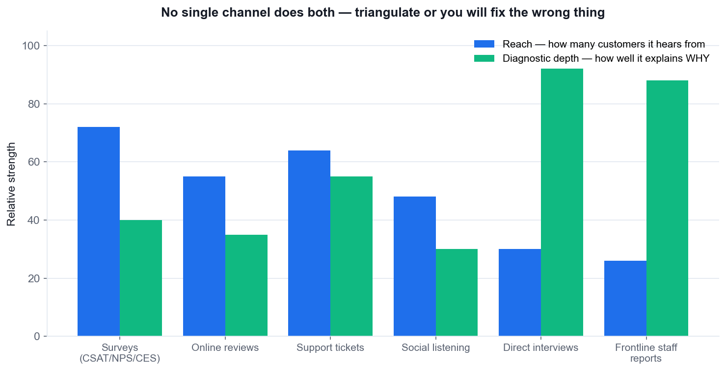
K2 · CUSTOMER FEEDBACK CHANNELS
Feedback Channels — Reach vs Diagnostic Depth
Surveys reach widest
CSAT/NPS/CES cover many customers but rarely explain WHY.
Interviews go deepest
Few customers, but they surface the mechanism behind the score.
Staff reports are gold
Frontline staff see causes that customers only experience as symptoms.
Triangulate always
No single channel does both — one channel alone fixes the wrong thing.
Improve Your Business with Excellent Customer Service · TGS-2025056191
© 2026 Tertiary Infotech Academy Pte Ltd
77

Slide 78
MEASURING SERVICE
The Three Service Metrics — and What Each Actually Measures
Metric
The question it asks
What it is good for
Its blind spot
CSAT
How satisfied were you with this interaction?
A specific moment — one agent, one ticket, one visit.
Says nothing about the overall relationship.
NPS
How likely are you to recommend us?
The whole relationship and word-of-mouth risk.
One number; gives no reason without a follow-up question.
CES
How much effort did you have to spend?
Predicts disloyalty better than satisfaction does.
Focuses on friction, not on delight or emotional loyalty.
Use them together: CSAT for the moment, NPS for the relationship, CES for the friction.
Improve Your Business with Excellent Customer Service · TGS-2025056191
© 2026 Tertiary Infotech Academy Pte Ltd
78

Slide 79
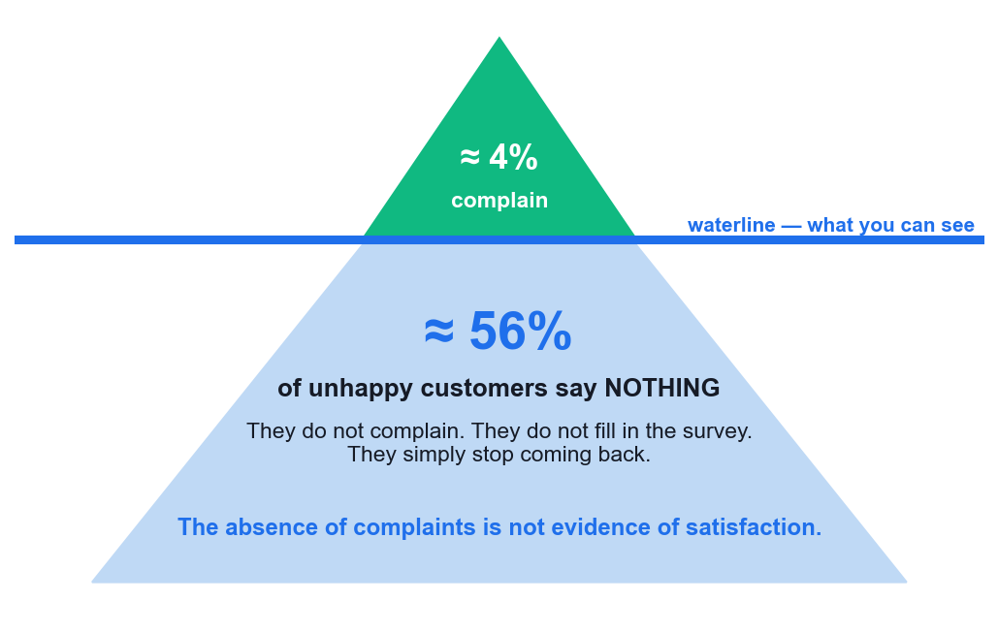
THE SILENT MAJORITY
Most Unhappy Customers Never Complain
~4% complain
Only a small fraction ever tell you there is a problem.
~56% say nothing
They do not complain, do not answer the survey — they just stop coming back.
Silence is not health
The absence of complaints is not evidence of satisfaction.
Go and look
If you only react to complaints, you are managing the visible 4%.
Improve Your Business with Excellent Customer Service · TGS-2025056191
© 2026 Tertiary Infotech Academy Pte Ltd
79

Slide 80
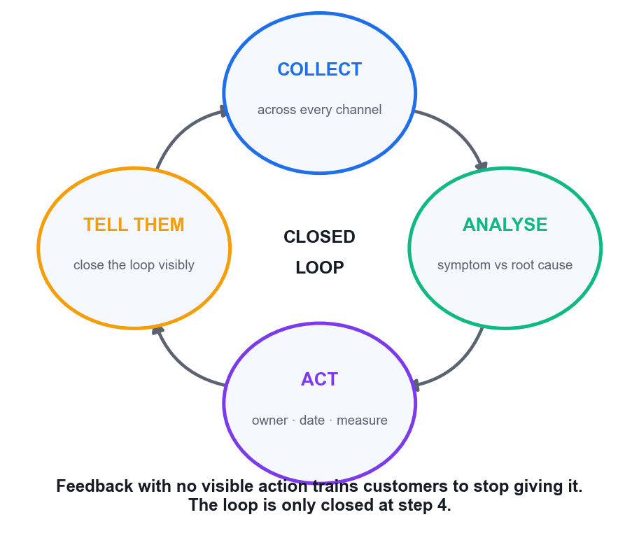
K2 + A3 · FROM FEEDBACK TO IMPROVEMENT
Closing the Loop — the Only Cycle That Changes Anything
Collect
Across every channel, deliberately — including from your own staff.
Analyse
Separate symptoms from root causes. The wait is a symptom; the staffing gap is the cause.
Act
An owner, a date and a measure. Anything less is an intention, not an action.
Tell them
The step everyone forgets — and the only one the customer can see.
Feedback with no visible action trains customers to stop giving it — and your early-warning system goes dark.
Improve Your Business with Excellent Customer Service · TGS-2025056191
© 2026 Tertiary Infotech Academy Pte Ltd
80

Slide 81
WHERE OPERATIONAL INSIGHT COMES FROM
Operational and Personnel Feedback Channels (K3)
Shift huddles and briefings
Short, daily, structured — the fastest route from frontline observation to action.
Frontline incident logs
A written record of what actually happened, not what the system recorded.
1
2
Team retrospectives
Regular review of what broke and why, with an owner assigned to each fix.
Internal escalation reports
Patterns in what gets escalated reveal where authority is missing.
3
4
Quality assurance scorecards
Reviewed interactions scored for tone, clarity and accuracy.
Suggestion and defect channels
A formal route so a known bug never sits in a WhatsApp group for months.
5
6
Customer channels tell you WHAT went wrong. Personnel channels are usually the only ones that tell you WHY.
Improve Your Business with Excellent Customer Service · TGS-2025056191
© 2026 Tertiary Infotech Academy Pte Ltd
81

Slide 82
TOPIC 07 · CASE STUDY
ACTIVITY 7 · 20 MIN
Activity 7 — Closing the Loop — F&B Chain Losing Repeat Customers
THE SCENARIO
Kopi & Co is a Singapore café chain with 9 outlets. Repeat-customer rate has fallen 15% this quarter. Management wants a recovery plan. Here is the feedback that exists:
GOOGLE REVIEWS (rating fell 4.4 → 3.8): 'Waited 25 min for a flat white at Raffles Place, staff seemed overwhelmed.' · 'Ordered on the app, got the wrong drink twice.' · 'Nobody acknowledged me at the counter for 5 minutes.' · 'Food is still great, service has really slipped.'
POST-VISIT SURVEY (CSAT 62%, down from 81%): lowest-scoring item is 'speed of service' (48%); highest is 'product quality' (91%). Only 4% of visitors complete the survey.
FORMAT Case Study + Group Presentation
ROLES Groups of 4–5. Each group presents a 3-minute plan to the class acting as management.
Full step-by-step instructions: Learner Guide, Activity 7 · Activities folder: activities/activity-07/
Improve Your Business with Excellent Customer Service · TGS-2025056191
© 2026 Tertiary Infotech Academy Pte Ltd
82

Slide 83
TOPIC 07 · WORK IN YOUR GROUP
Activity 7 — Discussion Questions
1
Sort every piece of feedback by CHANNEL. What is each channel good at capturing, and what does each one miss?
2
Only 4% complete the survey and CSAT is 62%. What is wrong with concluding '62% of our customers are satisfied'?
3
Separate SYMPTOMS from ROOT CAUSES. The 25-minute wait is a symptom — what is causing it?
4
The staff feedback identifies the app modifier bug that support tickets only show as 'wrong item'. What does that tell you about operational feedback channels?
5
Not one customer who left feedback has heard anything back. What does that cost, beyond this quarter?
6
Build the plan: at least 3 strategies, each with an owner, a timeline and a success measure. What will you measure, and when will you know it worked?
20 minutes · Groups of 4–5. Each group presents a 3-minute plan to the class acting as management.
Improve Your Business with Excellent Customer Service · TGS-2025056191
© 2026 Tertiary Infotech Academy Pte Ltd
83

Slide 84
TOPIC 07 · WHAT GOOD LOOKS LIKE
Activity 7 — Debrief
Channel biases: reviews capture the extremes (delighted and furious) and skew negative; surveys capture the compliant middle; tickets capture only what customers bothered to report; staff feedback captures CAUSES the other three only show as symptoms.
4% response rate means severe non-response bias — and roughly 56% of unhappy customers never complain at all. 62% CSAT is the score of the 4% willing to answer, not of the customer base.
Root causes are: (1) the June app update dropped the modifier field, (2) Raffles Place is 2 baristas short since May, (3) there is no closed loop so nothing gets fixed. The 25-minute wait and the wrong drinks are downstream of these.
The staff channel had the highest-value diagnostic information in the whole case — and it was sitting in an informal WhatsApp group because no formal operational feedback channel exists. This is exactly K3.
Silence costs the future: customers who give feedback and see nothing change stop giving feedback, and the early-warning system goes dark. The 15% drop is what you can see; the lost channel is what you cannot.
A good plan is specific: 'Ops Manager fixes the modifier field by 5 Sept, measured by wrong-item tickets falling below 10/week' beats 'improve the app'. Push every group to name an owner, a date and a number.
TEST IT Your plan names 3 root causes (not symptoms), has an owner and date for every strategy, includes a numeric success measure, and contains an explicit mechanism for telling customers what changed.
Improve Your Business with Excellent Customer Service · TGS-2025056191
© 2026 Tertiary Infotech Academy Pte Ltd
84

Slide 85
08
TOPIC 08
Recovering Difficult Customers
De-escalation · HEARD and LAST · common ground · limits · managing your own emotions
Improve Your Business with Excellent Customer Service · TGS-2025056191
© 2026 Tertiary Infotech Academy Pte Ltd
85

Slide 86
TOPIC 08 · LU2 · K1, K3, A3 · 50 min
Topic 8 — Key Concepts
Recovery restores the relationship
The goal is not only to fix the fault but to rebuild the trust the fault destroyed.
HEARD framework
Hear · Empathize · Apologize · Resolve · Diagnose — let them finish, then act, then prevent the recurrence.
1
2
LAST framework
Listen · Apologize · Solve · Thank — thank them for surfacing a problem you would otherwise not have seen.
Perceived justice has three parts
Customers judge the outcome, the process and how they were treated. Fix the fault and still fail on the last two.
3
4
Establish common ground
'We both want this resolved fairly today' converts an adversarial exchange into a shared problem.
Manage yourself first
Detach from the personal, control breathing and pace, keep language neutral. Composure is the de-escalation tool.
5
6
Improve Your Business with Excellent Customer Service · TGS-2025056191
© 2026 Tertiary Infotech Academy Pte Ltd
86

Slide 87
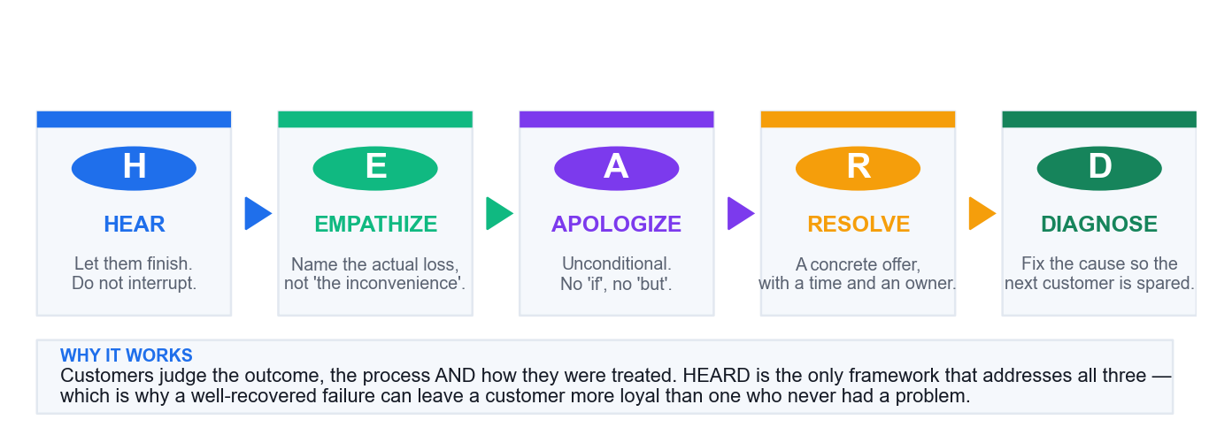
THE RECOVERY SEQUENCE
HEARD — the De-escalation Framework
Hear then Empathize
Let them finish, then name the actual loss — not 'the inconvenience'.
Apologize unconditionally
No 'if', no 'but'. A conditional apology is heard as a denial.
Resolve concretely
An offer with a time and an owner, made now rather than promised later.
Diagnose the cause
Fix the process so the next customer never meets this problem.
Improve Your Business with Excellent Customer Service · TGS-2025056191
© 2026 Tertiary Infotech Academy Pte Ltd
87

Slide 88
PICK ONE AND USE IT CONSISTENTLY
Two Recovery Frameworks — HEARD and LAST
Stage
HEARD
LAST
What it achieves
1
Hear
Listen
The customer gets to finish — and you get the real facts.
2
Empathize
Apologize
The customer's experience is acknowledged as legitimate.
3
Apologize
Solve
Ownership is taken and a concrete route forward appears.
4
Resolve
Thank
The problem is fixed — and surfacing it is treated as a favour.
5
Diagnose
—
The root cause is closed so it cannot recur.
LAST is faster for a live counter or call; HEARD adds the Diagnose step that prevents the recurrence.
Improve Your Business with Excellent Customer Service · TGS-2025056191
© 2026 Tertiary Infotech Academy Pte Ltd
88

Slide 89
WHY A CORRECT FIX CAN STILL FAIL
Perceived Justice — What the Customer Is Actually Judging
1
OUTCOME
2
PROCESS
3
TREATMENT
4
THE TRAP
Did I get a fair result? The refund, the replacement, the fix. Usually the only part organisations measure.
Was it fair and reasonable to get there? How long, how many repeats, how many transfers.
Was I treated with respect and taken seriously? Often the part that decides whether they return.
Fix the outcome, fail the other two, and the customer still leaves — while your metrics show a resolved case.
When you cannot change the outcome, process and treatment are still entirely within your control.
Improve Your Business with Excellent Customer Service · TGS-2025056191
© 2026 Tertiary Infotech Academy Pte Ltd
89

Slide 90
COMMON GROUND · LIMITS · EMOTIONS
Managing Yourself in the Difficult Conversation
1
Establish common ground first
'We both want this resolved fairly today' turns an opponent into a co-problem-solver.
2
Depersonalise
They are angry at the situation and the company. Absorbing it as a personal attack costs you the next customer too.
3
Control your physiology
Slow the breath, slow the speech, drop the volume. Composure IS the de-escalation tool.
4
Set limits once, calmly
State clearly what you can and cannot do. Repeating it or defending it invites haggling.
5
Never haggle over a loss
Give the maximum you can authorise immediately, then escalate the rest openly and on their side.
6
Close the loop afterwards
Tell them what changed a week later. That single follow-up converts detractors.
Improve Your Business with Excellent Customer Service · TGS-2025056191
© 2026 Tertiary Infotech Academy Pte Ltd
90

Slide 91
TOPIC 08 · CASE STUDY
ACTIVITY 8 · 15 MIN
Activity 8 — Service Recovery Under Pressure — The Wedding Catering Failure
THE SCENARIO
You are the Duty Manager for a Singapore catering company. Yesterday you catered a 200-guest wedding at a hotel ballroom in Novena. Three failures occurred: the vegetarian main course (40 portions, pre-ordered and confirmed in writing) was never loaded onto the truck; service started 35 minutes late; and the wedding cake was delivered with visible damage to one side.
The bride's father, Mr Wong, paid S$18,400. He is in your office now. He has photographs. He has already posted a one-star review naming your company. He is demanding a full refund and says he will 'make sure nobody in Singapore uses you again'.
What you know internally: the vegetarian order WAS in the system — the kitchen printed the run sheet before the final amendment was saved, a known gap flagged twice by kitchen staff and never fixed. Your authority extends to a 40% refund; anything beyond that needs the Director, who is contactable.
FORMAT Role Play + Case Study
ROLES Pairs or trios. A = Duty Manager, B = Mr Wong, C = observer scoring against HEARD.
Full step-by-step instructions: Learner Guide, Activity 8 · Activities folder: activities/activity-08/
Improve Your Business with Excellent Customer Service · TGS-2025056191
© 2026 Tertiary Infotech Academy Pte Ltd
91

Slide 92
TOPIC 08 · WORK IN YOUR GROUP
Activity 8 — Discussion Questions
1
Apply HEARD to this case. Write what you would actually SAY at each of the five stages.
2
You cannot undo the wedding. What are you actually recovering, and is recovery even possible here?
3
Mr Wong demands a full refund; you can authorise 40%. How do you set that limit without sounding like you are haggling over his daughter's wedding?
4
The kitchen flagged the run-sheet gap twice and nothing was done. Do you tell Mr Wong that? Argue both sides.
5
Perceived justice has three parts — outcome, process and treatment. Which of the three can you still influence here?
6
Design the process fix. What exactly changes so this cannot happen to the next customer?
15 minutes · Pairs or trios. A = Duty Manager, B = Mr Wong, C = observer scoring against HEARD.
Improve Your Business with Excellent Customer Service · TGS-2025056191
© 2026 Tertiary Infotech Academy Pte Ltd
92

Slide 93
TOPIC 08 · WHAT GOOD LOOKS LIKE
Activity 8 — Debrief
HEARD in practice — Hear: let him show the photographs and finish, however long it takes. Empathize: 'this was your daughter's wedding and we damaged it' — name the actual loss, not 'the inconvenience'. Apologize: unconditional, no 'if' and no 'but'. Resolve: a concrete offer, now. Diagnose: the run-sheet gap, named to him as a real fix.
What you are recovering is not the wedding — it is Mr Wong's standing. He chose this vendor and it failed in front of 200 guests including his extended family. The dignity loss is larger than the money.
Setting the limit: never haggle. State the 40% as immediate and unconditional, then say you are taking the rest to the Director TODAY with your own recommendation, and give a time you will call back. Being on his side of the table is the move.
Disclosing the known gap: strong arguments both ways. Disclosing shows honesty and makes the fix credible; it also hands him evidence of negligence. Most groups land on acknowledging a 'known process gap we failed to close' without the detail that it was flagged twice — accurate, honest, not self-incriminating. There is no single right answer here and the discussion is the point.
Outcome is largely fixed (money is all that is left). But PROCESS and TREATMENT are entirely still in your hands — and research on perceived justice says those two often matter more than the refund amount.
The fix: lock the run sheet against the live order record at print time, or block printing until amendments are closed. Then close the loop — tell Mr Wong what changed, in writing, a week later. That last step is what converts a detractor.
TEST IT All five HEARD stages were delivered, your apology contained no conditional words, you set the 40% limit once without haggling, and you produced a written process fix with an owner.
Improve Your Business with Excellent Customer Service · TGS-2025056191
© 2026 Tertiary Infotech Academy Pte Ltd
93

Slide 94
09
TOPIC 09
Understanding When to Escalate
Functional vs hierarchical escalation · triggers · the three-strike rule · documentation · POHA
Improve Your Business with Excellent Customer Service · TGS-2025056191
© 2026 Tertiary Infotech Academy Pte Ltd
94

Slide 95
TOPIC 09 · LU2 · K3, A3 · 45 min
Topic 9 — Key Concepts
Escalation is a decision, not a failure
Handing over to the right authority or expertise faster is better service than struggling on alone.
Functional vs hierarchical
Functional escalation goes sideways to expertise; hierarchical escalation goes upward to authority.
1
2
Angry is not the same as abusive
An angry customer attacks the problem. An abusive customer attacks you — that line is the escalation trigger.
Know the trigger behaviours
Vulgarity, personal insults, discriminatory remarks, legal threats and any threat of physical harm.
3
4
The three-strike rule
Two clear, calm warnings that the behaviour must stop, then escalate or end the interaction.
Singapore protects service staff
POHA 2014 criminalises workplace harassment; incidents can go to TAFEP or the police. Document everything.
5
6
Improve Your Business with Excellent Customer Service · TGS-2025056191
© 2026 Tertiary Infotech Academy Pte Ltd
95

Slide 96
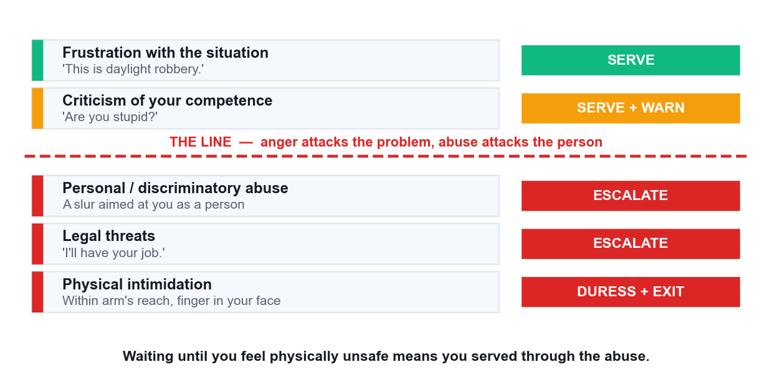
THE ESCALATION THRESHOLD
Where the Line Is — Anger vs Abuse
Anger attacks the problem
Loud, frustrated, even rude about the situation — still serviceable.
Abuse attacks the person
Slurs, personal or discriminatory attacks. This is the threshold.
Threats escalate instantly
Legal threats go to a manager; physical threats end the interaction.
Do not wait to feel unsafe
If you wait for physical fear, you have already served through the abuse.
Improve Your Business with Excellent Customer Service · TGS-2025056191
© 2026 Tertiary Infotech Academy Pte Ltd
96

Slide 97
K3 · THE ESCALATION DECISION
Two Kinds of Escalation — Know Which One You Need
FUNCTIONAL (sideways)
HIERARCHICAL (upward)
• The issue needs EXPERTISE you do not have.
• Technical faults, billing calculations, specialist products.
• Goes to a specialist team, not up the hierarchy.
• The customer is reasonable — the problem is hard.
• Introduce the specialist and hand over the context.
• The issue needs AUTHORITY you do not have.
• Goodwill beyond your limit, policy exceptions, abuse.
• Goes to a supervisor or duty manager.
• The problem may be simple — your mandate is the constraint.
• Brief your supervisor before they meet the customer.
Same customer and same complaint can need either route — diagnose whether you are short of expertise or short of authority.
Improve Your Business with Excellent Customer Service · TGS-2025056191
© 2026 Tertiary Infotech Academy Pte Ltd
97

Slide 98
SETTING AND HOLDING THE BOUNDARY
The Three-Strike Rule in Practice
1
Warning one — name the behaviour
'I want to help you with this, but I can't continue if you speak to me that way.' Calm, specific, never sarcastic.
2
Warning two — state the consequence
'If that continues I'll need to hand this to my supervisor and end our conversation.'
3
Act on it
Escalate or end. A warning you do not act on teaches the customer that the boundary is fictional.
4
Immediate escalation overrides
Slurs, discriminatory abuse and any physical threat skip the warnings entirely.
5
Withdraw properly
Hand over in front of the customer, then physically step away. Do not keep serving after escalating.
6
Document verbatim
Date, time, exact words, witnesses, CCTV reference. Paraphrase destroys the evidence.
Improve Your Business with Excellent Customer Service · TGS-2025056191
© 2026 Tertiary Infotech Academy Pte Ltd
98

Slide 99
YOU ARE NOT REQUIRED TO ABSORB ABUSE
Your Legal Protection in Singapore
POHA 2014
The Protection from Harassment Act criminalises harassment, including abuse of workers at work.
TAFEP
The Tripartite Alliance for Fair & Progressive Employment Practices takes workplace harassment reports.
1
2
Police report
Threats of violence and serious harassment are criminal matters, not service problems.
Employer duty
Your employer is responsible for providing a workplace safe from harassment.
3
4
Documentation is evidence
Verbatim wording, times and witnesses are what any report will turn on.
Aftercare is not optional
A break, a supervisor debrief and a next-day follow-up after an abusive incident.
5
6
'It's part of the job' is not the standard. Singapore law explicitly protects public-facing workers.
Improve Your Business with Excellent Customer Service · TGS-2025056191
© 2026 Tertiary Infotech Academy Pte Ltd
99

Slide 100
TOPIC 09 · CASE STUDY
ACTIVITY 9 · 15 MIN
Activity 9 — Drawing the Line — Escalation and Abuse at a Service Counter
THE SCENARIO
You are a service officer at a telco flagship store on Orchard Road. Mr Douglas Teo is disputing a S$680 roaming bill from a trip to Australia. He says he was never told data roaming was not included. The account notes show a confirmation SMS was sent and opened. The charge is valid under the contract.
The interaction escalates over 8 minutes: 0:00 He raises his voice: 'This is daylight robbery.' 2:00 'Are you stupid? Can you even read English?' 4:00 He calls you an offensive name related to your race. 5:30 'I'm going to CASE, and I'll have your job. What's your full name and NRIC?' 7:00 He steps behind the counter line, moves within arm's reach, and points a finger in your face.
Other customers are present. Your supervisor is on the shop floor. There is a duress button under the counter and CCTV covering the area.
FORMAT Role Play + Decision Exercise
ROLES Trios. A = Service Officer, B = Mr Teo (trainer may play this role), C = supervisor/observer.
Full step-by-step instructions: Learner Guide, Activity 9 · Activities folder: activities/activity-09/
Improve Your Business with Excellent Customer Service · TGS-2025056191
© 2026 Tertiary Infotech Academy Pte Ltd
100

Slide 101
TOPIC 09 · WORK IN YOUR GROUP
Activity 9 — Discussion Questions
1
Go through the timeline. At each timestamp, classify the behaviour as ANGRY or ABUSIVE. Where exactly is the line?
2
Which timestamp is the point of no return — where continuing to serve is the wrong decision? Justify it.
3
Apply the three-strike rule to this timeline. What are your two warnings, word for word?
4
Is this functional escalation or hierarchical escalation? Would your answer change if the dispute were technical rather than behavioural?
5
He demands your full name and NRIC. What are you obliged to give, and what are you not?
6
At 7:00 he is within arm's reach and pointing at your face. What do you do in the next 5 seconds, in order?
7
What must go into the incident report, and why does the exact wording he used need to be recorded verbatim?
15 minutes · Trios. A = Service Officer, B = Mr Teo (trainer may play this role), C = supervisor/observer.
Improve Your Business with Excellent Customer Service · TGS-2025056191
© 2026 Tertiary Infotech Academy Pte Ltd
101

Slide 102
TOPIC 09 · WHAT GOOD LOOKS LIKE
Activity 9 — Debrief
The line: 0:00 and 2:00 are anger directed at the situation and then at your competence — unpleasant but serviceable. 4:00 is the crossing point: a racial slur is abuse of the PERSON and is a criminal matter under POHA, not a service problem.
Point of no return is 4:00, not 7:00. Most learners wait for the physical proximity. Waiting until you feel physically unsafe means you served through the abuse — the threshold is the slur, and it is not negotiable or 'part of the job'.
Warnings must be calm, specific and behavioural: 'Mr Teo, I want to help you with this bill, but I cannot continue if you speak to me that way.' Second: 'If that continues I will need to hand this to my supervisor and end our conversation.' Never sarcastic, never raised.
This is HIERARCHICAL escalation — it needs authority, not expertise. A technical roaming dispute would be FUNCTIONAL escalation to a billing specialist. Same customer, same bill, entirely different escalation path.
You give your first name or staff ID — that is standard and reasonable. You never give your NRIC or personal details. Deflect: 'my name is X and my staff ID is Y, and my supervisor will give you the complaint reference.'
At 7:00, in order: step back to restore distance, keep hands visible and open, do not turn your back, say clearly 'please step back behind the counter', signal or press for the supervisor, and press the duress button if he does not comply. Do not attempt to win the exchange.
The report needs date, time, location, the exact words used verbatim, witnesses present, CCTV reference, actions taken and who was notified. Verbatim matters because POHA and any police report turn on what was actually said — paraphrase destroys the evidence.
TEST IT You identified 4:00 as the escalation threshold, delivered two calm behavioural warnings, handed over without continuing to serve, and produced an incident report containing the verbatim wording and a CCTV reference.
Improve Your Business with Excellent Customer Service · TGS-2025056191
© 2026 Tertiary Infotech Academy Pte Ltd
102

Slide 103
WRAP-UP
Course Summary & Next Steps
Improve Your Business with Excellent Customer Service · TGS-2025056191
© 2026 Tertiary Infotech Academy Pte Ltd
103

Slide 104
LEARNING OUTCOMES DELIVERED
What You Achieved Today
1
Understood the service chain
External and internal customers, and why service quality is a chain not a department. (LO1)
2
Built a service attitude
Appearance, smile, energy, positivity and positive language under pressure. (LO1)
3
Identified customer needs
Active listening, open questioning, and the four levels of addressing needs. (LO1)
4
Served across every channel
In person, on the phone, and in writing — matching channel to issue. (LO1)
5
Turned feedback into improvement
Feedback channels, closing the loop, and root cause vs symptom. (LO2)
6
Recovered and escalated safely
HEARD and LAST, perceived justice, the three-strike rule and POHA. (LO2)
Improve Your Business with Excellent Customer Service · TGS-2025056191
© 2026 Tertiary Infotech Academy Pte Ltd
104

Slide 105
THE ONE THING TO REMEMBER
The absence of complaints is not evidence of satisfaction.
Go and look. Ask your customers, ask your frontline, and close the loop where it matters.
Improve Your Business with Excellent Customer Service · TGS-2025056191
© 2026 Tertiary Infotech Academy Pte Ltd
105

Slide 106
WE'RE HERE TO HELP
Support
Email
enquiry@tertiaryinfotech.com
Telephone
+65 6100 0613
1
2
Website
www.tertiarycourses.com.sg
LMS / TMS portal
lms-tms.tertiaryinfotech.com — courseware, assessment and certificates.
3
4
During the course
Ask your trainer at any point — including during the activities.
After the course
Contact us any time; we support learners after the class ends.
5
6
Improve Your Business with Excellent Customer Service · TGS-2025056191
© 2026 Tertiary Infotech Academy Pte Ltd
106

Slide 107
ASSESSMENT · REMINDER
Final Assessment
Oral Questioning (OQ) — 30 min
3 open-ended questions covering K1, K2 and K3. Individual, open book.
Role Play (RP) — 30 min
2 simulated customer interactions covering A1, A2 and A3. Individual, open book.
1
2
Open book
Slides, Learner Guide and approved materials only.
Both must be Competent
You must be assessed Competent in BOTH instruments to pass.
3
4
75% attendance required
Attendance and a Competent result are both needed for funding.
Appeals available
You may appeal if you disagree with the assessment outcome.
5
6
Oral Clarification of up to 10 minutes may be conducted 1:1 to close minor performance gaps — this is not counted in the assessment duration.
Improve Your Business with Excellent Customer Service · TGS-2025056191
© 2026 Tertiary Infotech Academy Pte Ltd
107

Slide 108
ON ASSESSMENT DAY
Assessment Flow
1
2
3
4
5
▶
▶
▶
▶
TRAQOM Survey
Assessment Digital Attendance
Assessment (OQ then RP)
Submit on the LMS
Sign the Assessment Summary Record
Improve Your Business with Excellent Customer Service · TGS-2025056191
© 2026 Tertiary Infotech Academy Pte Ltd
108

Slide 109
TRAQOM · SSG DIGITAL ATTENDANCE
Digital Attendance (Mandatory)
Three scans, every course day
AM at the start, PM after lunch, and again before the assessment.
The trainer shows the QR
Generated live from the SSG TRAQOM portal — it changes each session.
1
2
Scan with your phone camera
Open the camera, point at the QR, tap the link and submit.
Use your registered details
The NRIC/FIN you enrolled with, or the record will not match.
3
4
75% attendance minimum
Below this you are not eligible for the assessment or for funding.
Tell the trainer immediately
If your scan fails or you arrive late — it cannot be fixed after the day.
5
6
Digital attendance is a mandatory SSG funding requirement — it is not the same thing as the TRAQOM feedback survey.
Improve Your Business with Excellent Customer Service · TGS-2025056191
© 2026 Tertiary Infotech Academy Pte Ltd
109

Slide 110
SEE YOU AT THE COUNTER
Thank You!
You can now collect customer feedback, read what it actually says, and turn it into service that keeps customers.
Improve Your Business with Excellent Customer Service · TGS-2025056191
© 2026 Tertiary Infotech Academy Pte Ltd
110

